Slide 1
Welcome to the Airways public meeting
Subtitle
24 October 2013

Slide 2
Susan Paterson Airways Chair

Slide 3
Notes:
Good morning and welcome to Airways public meeting.
[introduce board members at meeting]
I hope you’ve had the opportunity to look at one of a number of innovative products that Airways has developed, the desktop Total Control simulator. It can simulate what happens in almost any air traffic control tower in the world. The simulator is an important tool for training air traffic controllers in New Zealand and has also been purchased overseas. For example during the last financial year a Total Control simulator was set up at the Polytechnic University of Catalonia, to join the one already in Madrid.

Slide 4
Notes:
2013 saw our dedicated staff of 760 continue to keep our skies safe and serve both our direct and indirect customers efficiently and effectively.
NOPAT and financials
During the year ended June 2013 the aviation sector internationally experienced some small signs of a gradual recovery. It appears that this will continue. Premium travel and cargo movements are trending upwards. While IATA has upgraded its annual forecast of earnings for the sector from $12 billion to $14 billion this still means the aviation sector will make only a 1.8% return for the year.
In international markets we see continuing uncertainty in Europe and the Middle East and, until recently, relative stability in the USA. We are getting mixed messages from Asia, which is a key market for our economy. The New Zealand outlook is for 2.5 - 4% growth in passenger numbers – that’s good news, but it’s not strong growth and comes off the back of 0.1% growth in aircraft movements in the last financial year.

Slide 5
Group NOPAT FY13 vs FY12 ($m)
Notes:
Despite these flat volumes, it has been a positive year for Airways. We achieved a net operating profit after tax of $21.7 million for the 2012–13 year, compared to $9.3 million for the previous financial year. A key driver of this improvement was the early termination of Airways’ Cross Border Lease (QTE Lease). This termination resulted in the release of deferred income of $18.8 million and an increase to NOPAT of $12.8 million.
The early termination of the QTE cross border lease was a significant achievement for Airways. We successfully exited the lease during a very narrow window when market conditions were their most favourable for many years. Audit and Finance Committee Chair, Susan Putt will give you a bit more information about the QTE lease shortly.
Airways Group net operating profit after tax, before the impact of the QTE lease termination, was $8.9 million. This result is down on the previous year’s NOPAT of $9.3m primarily driven by the $1.4 million cost to deliver Airways’ transformation project which we covered in last year’s public meeting. These costs were well below the $4.8 million budget as a result of tight controls and staff retention.

Slide 6
Notes:
CAPEX
This is a time of tremendous change in air navigation and surveillance. Air navigation service providers like Airways all over the world are transitioning from the conventional radar and ground-based surveillance of the past 60 years, to GPS technology.
We also invested heavily in improving our services setting an ambitious target for our capital expenditure programme. We achieved capital expenditure reaching $23.6 million for the year - a 32% increase over the previous year. This was achieved with a great effort from Airways technical and engineering teams. Recognition for some of those efforts came from our industry in Madrid earlier this year, when Airways collected the Jane’s Award for operational efficiency for the introduction of Performance Based Navigation – up against 80 other ANSPs.
Airways chief executive Ed Sims will talk more about some of the operational achievements and projects in his presentation shortly.

Slide 7
Delivering value for our customers
We estimate our services will provide
$70m+
in customer value over the next three years
$6m 30 extra flights a day
$37m of fuel savings
$22m of fuel savings
$3m of fuel savings
$2m of fuel savings
Notes:
Pricing
Another major piece of work concluded in the year was the 2013 - 16 pricing round. The setting of prices followed a comprehensive, robust and transparent consultation process. They were set at a level which will ensure that essential investments in the transition to new technology can be delivered. These investments, will in turn enable significant fuel savings for airlines.
Airways is at the forefront of the trend to adopt satellite-based surveillance systems, using innovations like performance-based navigation and collaborative arrival management to deliver fuel savings of $48 million over the last four years. Airways estimates it will provide another $70 million of fuel savings over the next three-year pricing period.
We are confident that the price increases faced by our customers over the next three years will be fully offset by the savings generated by our service improvements.

Slide 8
Notes:
Global Services
The current year continues the growth that began in the last year. Our global services business is not yet producing adequate returns, with a large amount of time during the year recovering debts in regions like the Middle East. However, a number of substantial opportunities are being pursued and the team is now able to commit themselves to building a sustainable international business.
Both our System Operator and our Global Services businesses have spent much of the last six months negotiating two important commercial arrangements.
The first was the CAA Aeronautical Information Management contract. This is a 10-year contract with CAA to provide aeronautical data and notifications to the industry, which Airways won in a competitive international tender. The contract includes a Flight Information Service - which provides weather, traffic, and hazard information for pilots - and a flight monitoring and emergency response if necessary. The contract took effect from 1 July this year.

Slide 9
Notes:
GroupEAD joint venture
The second was the signing of a Heads of Agreement between GroupEAD and Airways NZ. It is for the establishment of a new joint venture aeronautical information company to be called GroupEAD Asia Pacific. GroupEAD is a Spanish-based aeronautical information management (AIM) expert providing services across Europe. Airways will be the majority shareholder in GroupEAD Asia Pacific with an 80% shareholding.
The company will be a joint venture business delivering next-generation AIM services and procedure design services to the Asia Pacific region. The new business will be headquartered in Wellington, and is expected to start operations early in 2014. The 23 staff currently working at Airways head office in the aeronautical information management and procedure design services will work for the new joint venture business.
This puts New Zealand further on the world map to provide aeronautical information around Asia and the Pacific.
I’d now like to introduce Ed Sims, Airways chief executive, who will talk a little about Airways operational performance over the last year.

Slide 10
Ed Sims Airways Chief Executive
Notes:
Good morning everyone, and I’d like to join with our chair Susan Paterson in welcoming you to this meeting.

Slide 11
Notes:
The year ended 30 June 2013 has been one of growth and significant re-transformation for Airways. A vital pricing consultation process, investment in our asset base and a new senior management team have all advanced our progress as a business and as a service provider.
At the same time we have delivered some key projects that re-emphasise our focus on ensuring that every single one of our 1.1 million flights through the 30M kilometres of our Flight Information Region is as efficient as the previous flight.
Today I would like to focus on a few of those key domestic programmes of work – Multilateration and step changes in surveillance, Performance Based Navigation, our flow management tools CAM and AMAN, and finally the current hot topic of Smart Approaches.
I will then expand briefly on a couple of the opportunities raised by Susan Paterson in our international operations.

Slide 12
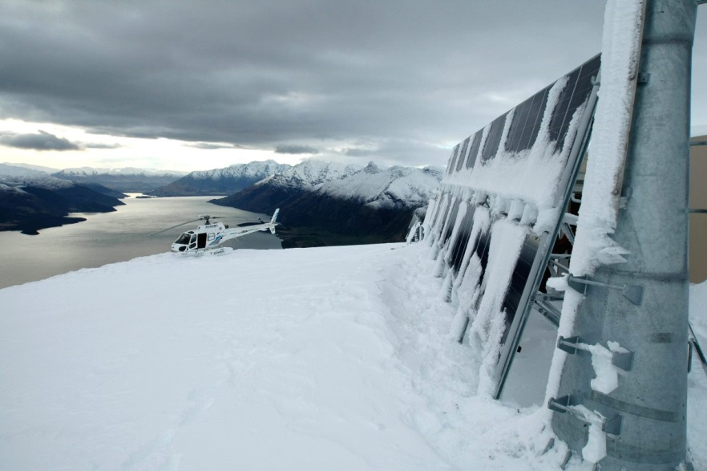
Notes:
Multilateration
In a major construction and engineering feat Airways installed nine air traffic surveillance sites high on the mountain peaks of the southern South Island during the year, adding to the 18 installed in 2009.
Enabling our air traffic controllers’ visibility into valleys and behind mountains using a three dimensional picture of air traffic has resulted in:
a safe reduction in separation standards between aircraft
fuel efficiencies and decreased costs for airlines as aircraft no longer need to hold at lower levels, and
fewer disruptions for passengers.
The sensors are deployed with minimal environmental impact, using existing communication sites, or are solar powered.
The installation has taken place in some of the most remote and exposed locations in the South Island. For example at Wether Range near Omarama, we drove a digger to the peak to dig the foundations, and then used a helicopter to fly in the 13 tonnes of concrete needed for the station foundations.

Slide 13
PBN: savings per year
Minutes delay: | 19,200 – 28,800
Fuel: | 480,000 – 720,000 kg
Dollars: | $630,000 - $950,000
Notes:
Rollout of PBN and Jane’s award
The rollout of the southern Performance Based Navigation has been a highly successful project.
Using GPS technology to maximise the use of airspace, we have been able to increase the number of hourly arrivals into Queenstown (flights per hour) in poor weather from 4 to 12. Other key data since the introduction of PBN:
reduced minutes of delay by between 19,200 and 28,000,
saved more than 500,000kgs of fuel
up to 2.25 million kgs of CO2 saved.
It was therefore icing on the cake to receive the prestigious international Jane’s ATC Award in the Operational Efficiency category. No small feat for a small ANSP who is determined to use the best of technology, innovative thinking and passionate people.

Slide 14
Notes:
Introduction of CAM and AMAN
In April 2013 Airways turned on the Arrival Management sequencing tool for air traffic bound for Auckland Airport.
This milestone was the culmination of an 18 month partnership between Airways and BARCO Orthogon GmbH. Airways role at our busiest airport has progressed from pure management to true enablement.
This is a world-first deployment of an integrated flow management and arrival management system, which will save airlines tens of millions of dollars in fuel by significantly reducing airborne delays and optimizing flight profiles.
In Auckland, airborne delay has reduced from an average of 3.5 minutes per flight in 2007 before Collaborative Flow Management was introduced, to an average of 23 seconds per flight in 2013 – an 89% reduction. Airlines arriving into Auckland Airport are experiencing an additional 2-4% reduction in delays as a direct result of the AMAN deployment into the CFM system.

Slide 15
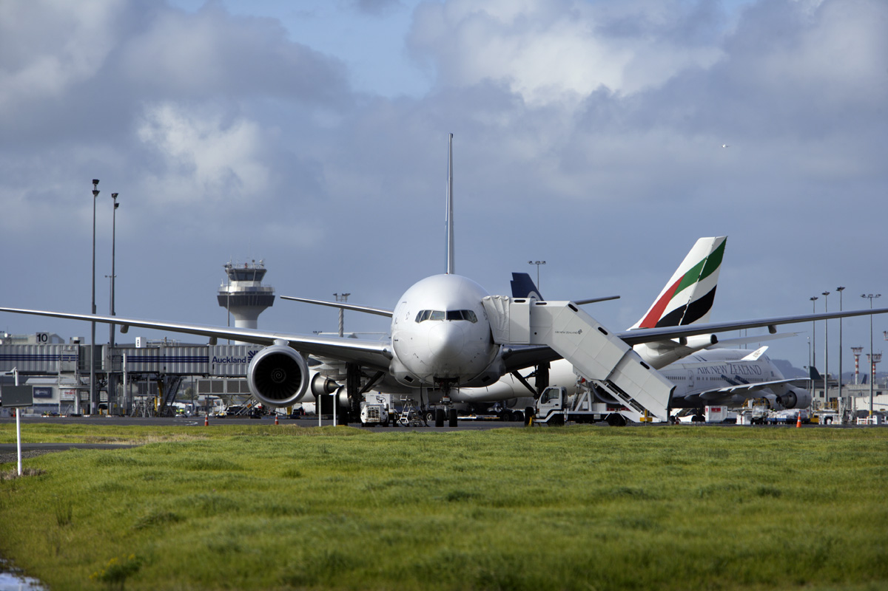
Notes:
SMART approaches
SMART approaches are already common in NZ and around the World. The purpose of trialling new approaches is to reduce fuel burn, time in the air and CO2 emissions. In plain terms SMART approaches use satellites to provide precise height, ground path and direction guidance to an aircraft to fly along a curved path using onboard equipment.
A new SMART approach to Auckland Airport is being trialled currently, finishing at the end of this month. Airways role is as technical advisor to the airlines and Auckland Airport on the SMART approach and use of the airspace.
You’ll be aware that there has been some public criticism in Auckland in the last several months over the SMART approach currently being trialled. While many of the concerns voiced related to overall volumes, especially at night, rather than specific to the 10 flights a day on the new approaches, all views and concerns are being fully factored into our evaluations.

Slide 16
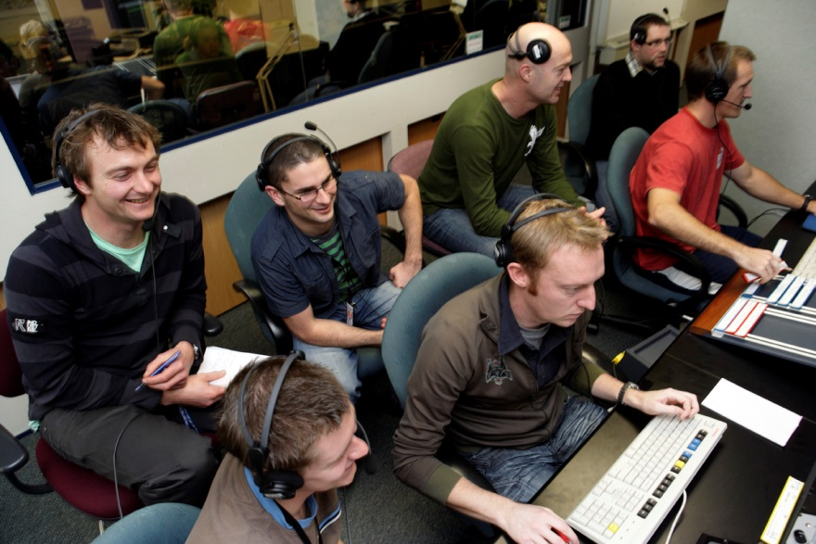
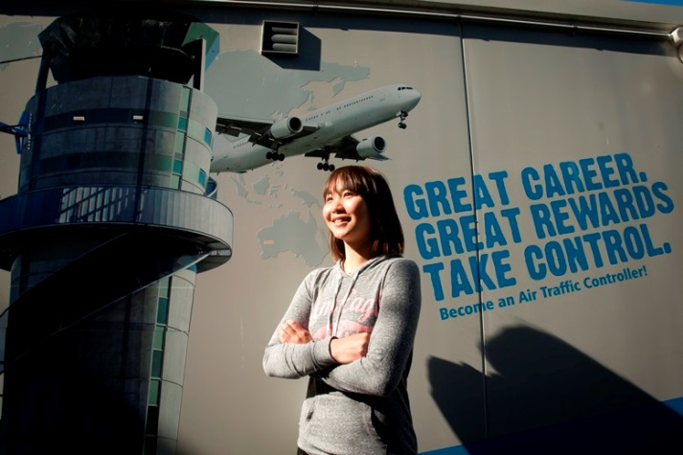
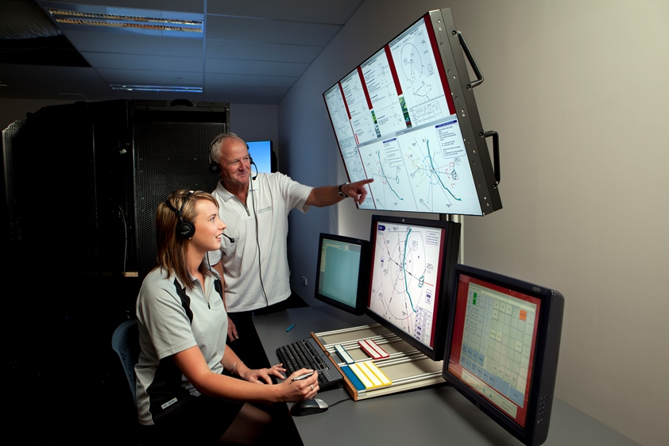
Notes:
Airways Global Services
While it has been a year of satisfying growth and pleasing operational achievements, there were some areas where we did not achieve our targets.
The income achieved by the new Airways division, Global Services, was lower than forecast as we deliberately pull back from resource hungry consultancy projects in favour of joint ventures and partnerships. These partnerships – like the delivery of an Asia Pacific Aeronautical Information service described by Susan Paterson, are replicable, sustainable and bring stronger strategic value in the medium term.
Flightyield
Earlier this year Global Services launched a cloud-based bureau billing service called Flightyield, partnering with aviation industry software giant SITA and the Civil Air Navigation Services Organisation (CANSO). This brand endorsement is a first for the industry’s Trade association, CANSO, with the product launched officially in Madrid in February.
Revenue management is a fundamental for commercial airlines but less well understood in air traffic control. Airways’ product is a genuine market leader in this area.
Airways Training
The training arm of Airways Global Services continues to provide best-practice air traffic control training courses throughout the world, this year catering for students from China, Hong Kong, Oman, Saudi Arabia, Papua New Guinea and, of course, New Zealand. During the year, Airways Training also achieved several important milestones.
A new training facility was built adjacent to the Massey University campus in Palmerston North, purpose-built to cater for overseas students such as those from the Gulf States and Asia. Both of the Airways training centres feature world-leading simulator suites using our Total Control simulators, like the demonstration model here today, providing students with real-world 3D graphics and technology. This same simulation, using Kiwi technology, is in active service currently across Europe and South Africa.

Slide 17
Notes:
CONCLUSION
It has been a pleasure to share with you some of our key successes during the year. Despite a challenging market and lower top-line revenues, we achieved net profit in excess of budget this year, and our strategies for the coming year place us well to achieve our growth targets.
Of course, there have been many others. These have been achieved through the hard work of our 760 staff and I would like to publicly thank them for their commitment and motivation during a year of change and transformation. I would also like to thank my management team for their leadership and energy, and the Board for their on-going support and direction.
Board member Susan Huria will now speak about some of the People issues that have enabled the transformation of Airways to take place.

Slide 18
Susan Huria Remuneration Committee Chair

Slide 19
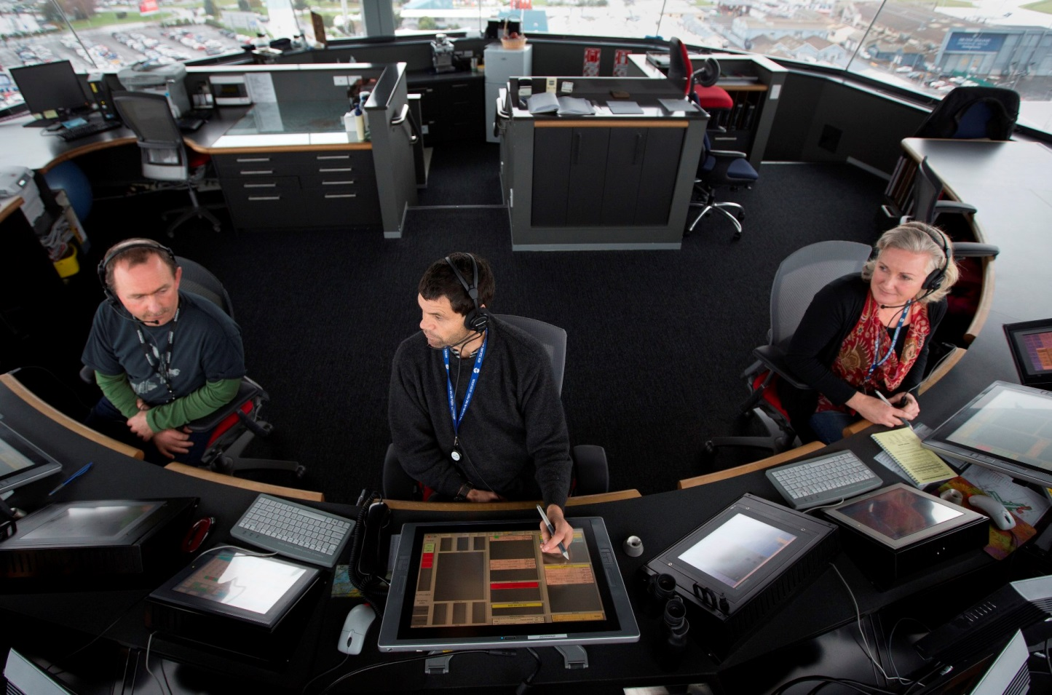
Notes:
Thank you Ed.
This morning I’m pleased to tell you about some of the People issues in the business during the year.
As both Ed and Susan have alluded to, it has been a year of transformation and growth. Change at the level and pace we’ve seen at Airways doesn’t happen without big impacts on the staff.
19 new roles
The transformation project which kicked off on 1 July led to the creation of 19 new roles. These included two new general managers - general manager of the new Global Services, Russell Hulstrom from Melbourne and General Manager of System Operator, Pauline Lamb from the UK. They joined existing GM Mark Loveard, who managed the transformation project, to run the three Airways businesses.
For the remaining positions we undertook a thorough search, in many cases a global search, to find the most competent and experienced people for the roles.
New roles were created in project management and we’re starting to reap the reward of having a dedicated project management office to support our ambitious capital expenditure programme. Our engineering and maintenance team has also been strengthened.
New staff were appointed to Global Services, a team of experienced global marketers who can develop and package a unique set of products to take to potential customers around the world. It is very early days for the global services team, with the last position filled just three months ago, but they are now in a position to fire ahead as a complete team.

Slide 20
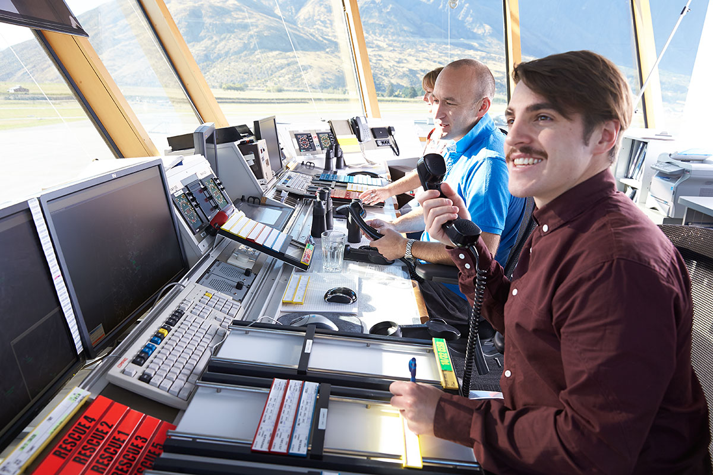
Notes:
Performance objectives
During the year we achieved a great business performance milestone. 100% of staff who are on individual employment agreements now have performance management plans and incentives in place. Putting our IEA staff on performance management arrangements is starting to drive and reward positive behaviours, attitudes and outcomes.
The Board is assured that the business goals of the company have cascaded through the organisation with all staff working together to reach pre-agreed objectives.
Staff engagement survey
Every year Airways undertakes a Staff Engagement Survey. Given the amount of change in the business it is perhaps not surprising that engagement fell from 74% to 70%. However, it was a strong wakeup call to both the Board and to senior managers that we need to make sure that we are bringing our staff on the transformation journey with us.
In response, a new People strategy has been created, not driven by the HR team or the executive, but driven by the 75 leaders in the business. The strategy has four pillars – belonging, leadership, talent and performance.

Slide 21
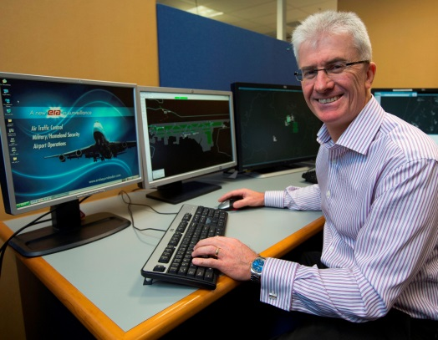
Notes:
Moving forward
I’ll now hand over to Susan Putt for a brief audit and finance update.

Slide 22
Susan Putt Audit & Finance Committee Chair
Notes:
Thank you Susan. I’m Susan Putt, chair of the audit and finance committee.
It’s been another full year for the committee, with some unique challenges. Susan Paterson mentioned to you the QTE lease, which lead to an increase in NOPAT of $12.8 million.

Slide 23
US 10-year bond rates
Notes:
QTE lease
By way of background, earlier in the 2000s Airways entered into a cross border lease of Skyline Air Traffic Management System and Surveillance Systems equipment. The arrangement was for 24 years and was to expire in 2027.
Airways successfully terminated this lease early in July 2012 at a time when market conditions were at a favourable position, as you can see in the slide. Specifically the exit value was linked to the return on United States (US) long term treasury bonds and Airways managed to exit the lease at the optimal time when US treasury rates were at an all time low.
As I mentioned, the termination resulted in an increase in NOPAT of $12.8 million during the financial year with the release of deferred income from Airways balance sheet. The early termination provides Airways with more financial certainty and flexibility in progressing with next generation infrastructure investment.

Slide 24
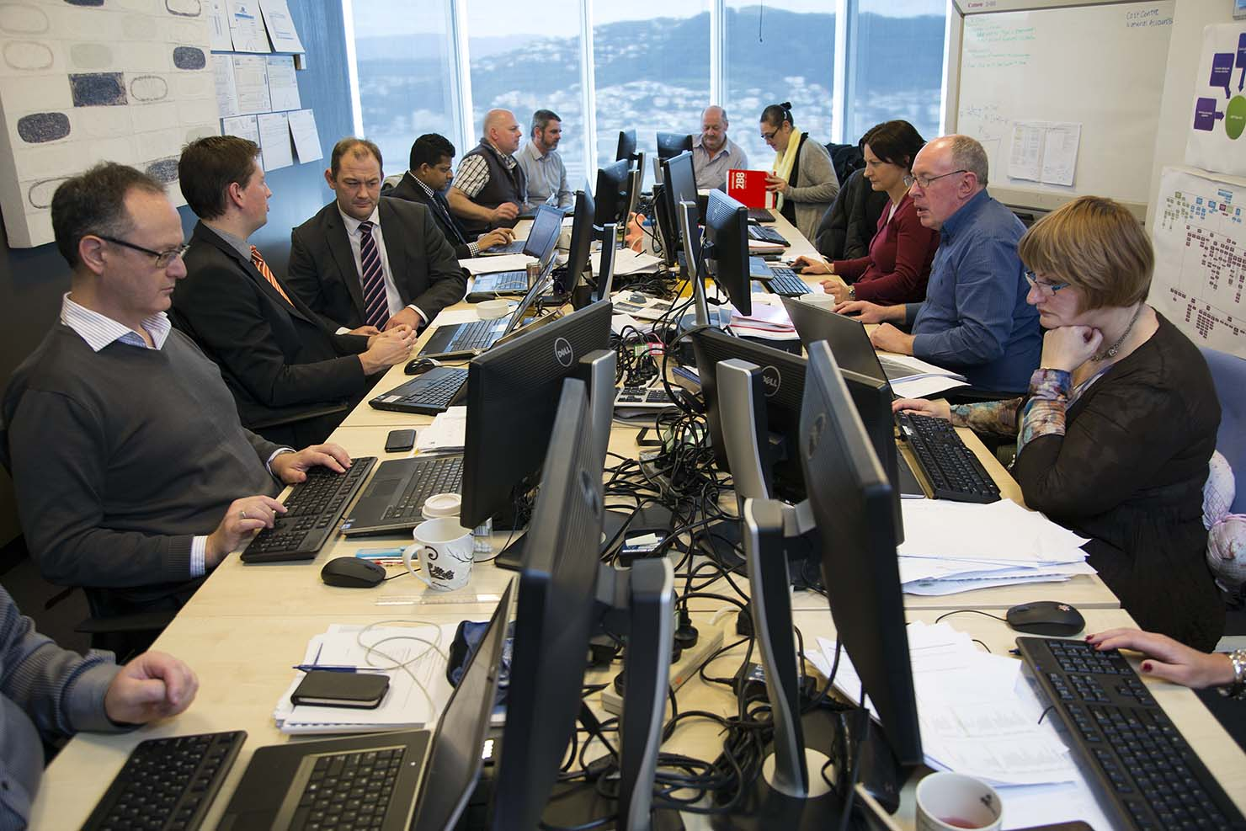
Notes:
Project BAIT
One of the capital projects that hasn’t been mentioned so far is Project BAIT. Project BAIT - Bringing Airways Information Together – is a one-in-20-year overhaul of our financial management systems to deliver world class, best practice financial services to the business.
The design and implementation phase began in February 2013, and the system is scheduled to go live in just one week. Once the project is complete and the new finance system goes live, Airways processes will be simpler and faster and staff will have easy access to reports and real time information.
Audit Result & Excellence rating
A milestone for the year was achieving the top rating from the Office of the Auditor General for Airways’ Management Control Environment and also for our Financial Information Systems and Controls.
Both our management and financial systems are now at the top rating level provided by our external auditors. This has topped off a successful year for Airways from an audit and finance perspective.
Dave Park, the chair of our safety committee will now give you a brief update on Airways safety activities.

Slide 25
David Park Safety Committee Chair
Notes:
Hello, I’m David Park, chair of the Safety committee.
During a year of considerable change for Airways, safety has remained at the forefront of our minds.
The key milestone for the year was ensuring no high risk safety incidents attributable to Airways performance. This is the result that we strive for every year and the Board is unrelenting in its expectation of this achievement.
I’d like now touch on just some of the key safety-related activities and achievements at Airways over the last financial year.

Slide 26
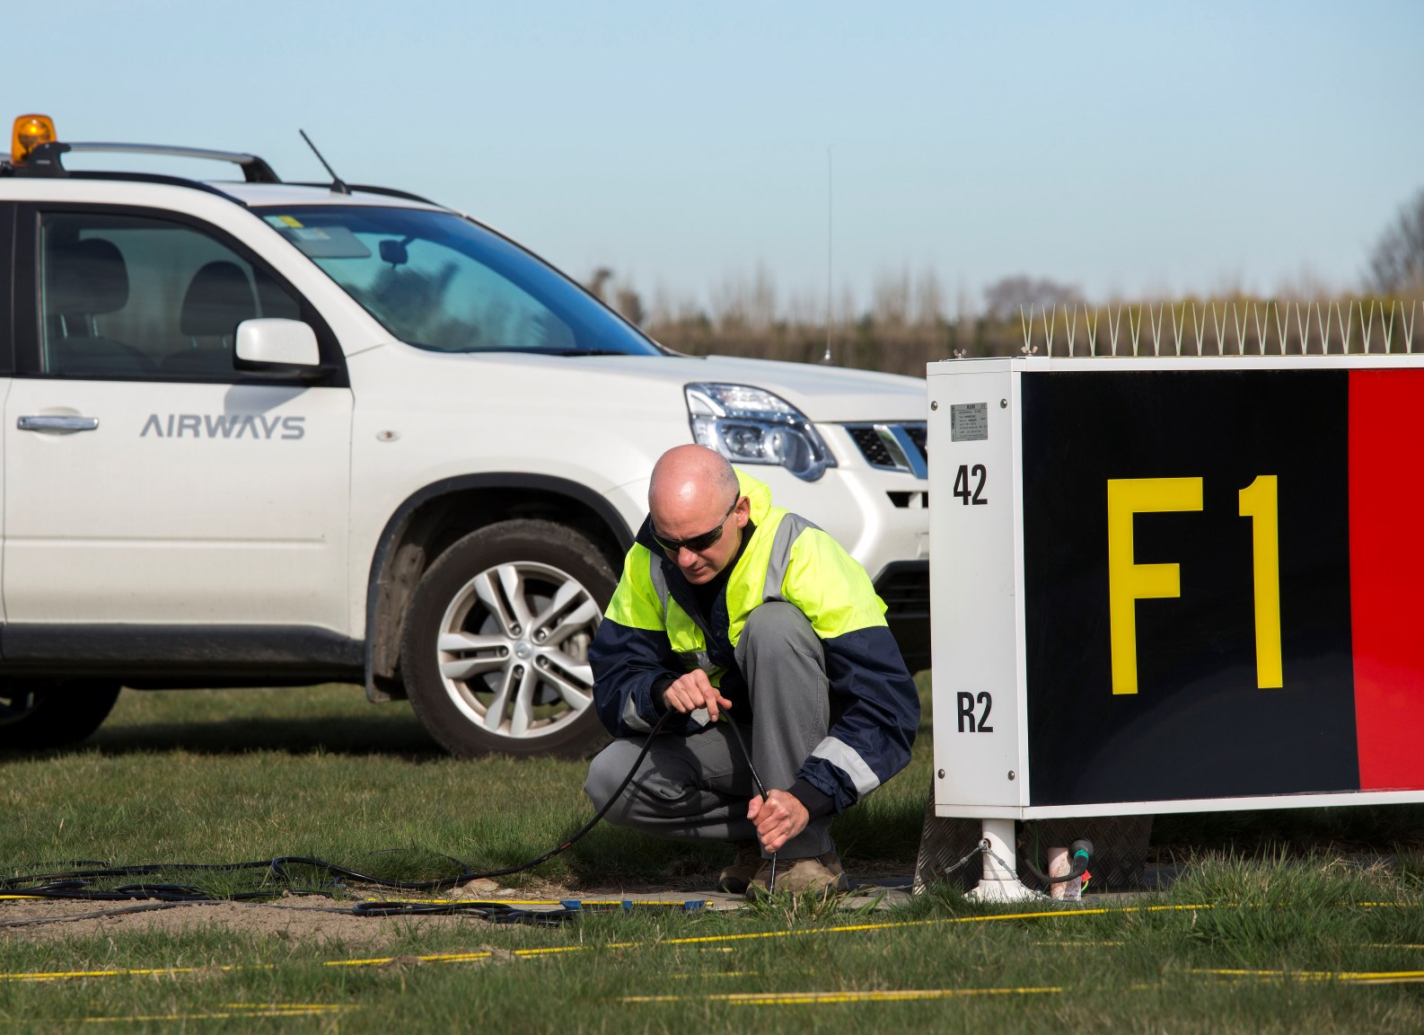
Notes:
Safety in core ATC operations
It is gratifying to report Airways enabled 1.1 million flight movements during the year with no high risk incidents and a service availability of 99.88%. Our safety performance places us in the top decile compared with other global ATC providers but we continue to strive for improvements.
Airways initiated a robust safety management system (SMS) refresh programme that will provide an effective SMS in line with global best practice. The four pillars of the SMS are:
Leadership and Policy
Risk Management
Risk Assurance
Training, Feedback and Promotion.
Elements for the Leadership and Policy pillar were established during the last quarter of the financial year and included the integration of people safety into the Safety Management System. The safety of Airways people and operations is always the first item discussed in our Board meetings, and I know the weekly executive team meetings give safety the same emphasis and visibility.
By encouraging our staff to be proactive in identifying potential sources of harm, we aim to continually reduce our injury rates. We were pleased to see injury numbers halved from the previous year and a rise in voluntary hazard reports.
NOSS
An extensive survey of our airfield and radar operations (called NOSS - normal operations safety survey) took place during the year and provided valuable insight into our normal practices, comparing our operational standards with those of other service providers. While the review showed Airways benchmarked very well it identified several areas that would benefit from targeted improvement programmes which we have since implemented.

Slide 27
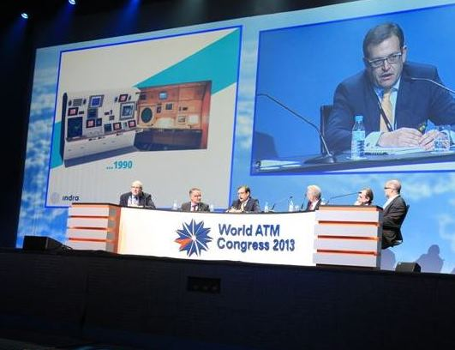
Notes:
CANSO
Airways chief executive Ed Sims has retained his appointment as the head of the Civil Air Navigation Service Organisations Safety Sub Committee. While this will involve a significant commitment of Ed’s time, it is extremely beneficial to have New Zealand represented at the highest international level of air navigation safety and the Board is very supportive of his participation.
Business Leaders Forum
Just last month the Business Leaders’ Health and Safety Forum met in our Christchurch offices and toured our facilities.
The Forum is a coalition of business and government leaders committed to improving the performance of workplace health and safety in New Zealand. Their focus is to make workplaces safer by growing world-class CEO safety leadership in New Zealand, and by leveraging the combined skill, influence and resources of members.
The Forum has more than 100 members who are CEOs or Managing Directors of significant New Zealand companies. Ed Sims has taken a lead role in this forum over the last couple of years, ensuring an awareness of the issues faced by Airways across NZ business and giving Airways access to a pool of talent and information to access for our own safety activities.
I’ll now hand back to Susan Paterson.

Slide 28
Susan Paterson Airways Chair
Notes:
We now have some time to answer any questions that you may have.

